Slide 1
Scripted LFS 78
Romain Claret
github.com/Rocla/lfs-7.8

Slide 2
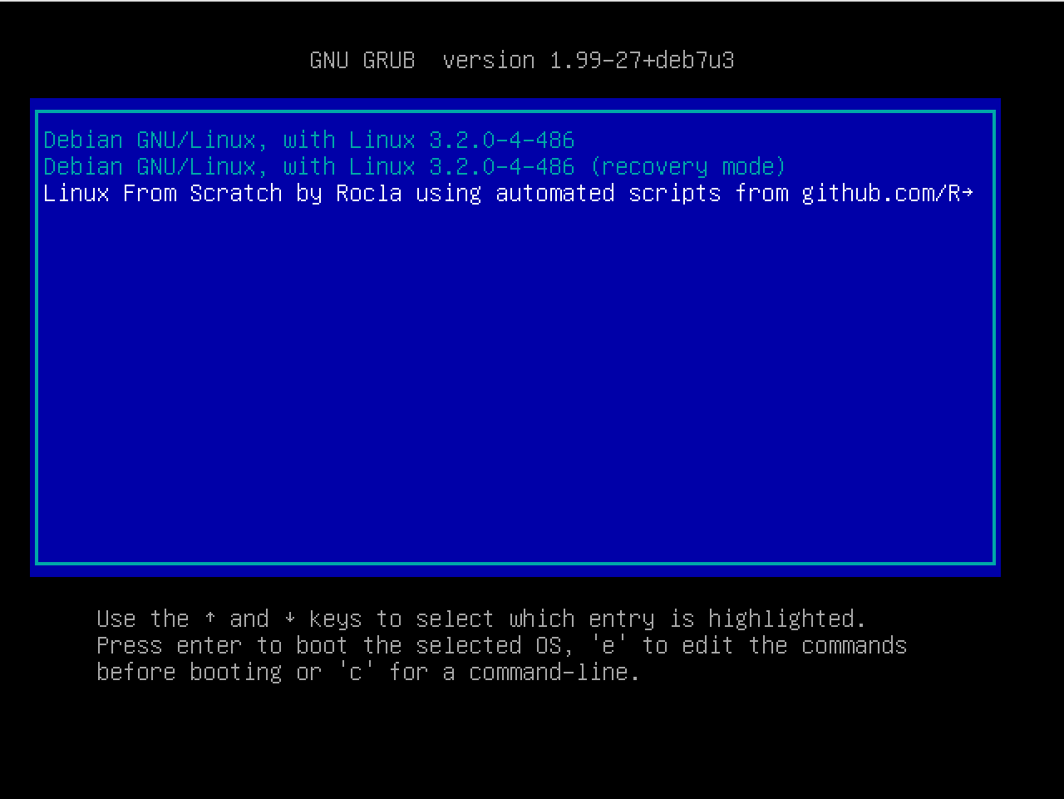
What is it?
Scripted version of the book LFS 7.8
Running all the steps until the reboot of 9.3
English
Details for each steps
Boot from the GRUB of the host machine
Slide 2/5

Slide 3
Host Machine
VirtualBox
Host machine installer: debian-7.8.0- i386-xfce-CD-1.iso
Core: 1
Ram: 12GB
Host HDD: 40GB
LFS HDD: 20BG
Slide 3/5

Slide 4
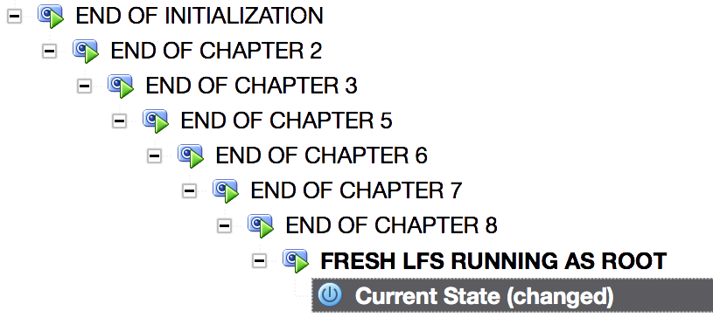
How to Start?
Clone the repo on your freshly installed debian
Go to the folder (default: lfs-7.8)
Give the permission rights to the first file (chmod +x 0.0-root_initial.sh)
Run the first file (./0.0-root_initial.sh)
Then you have the options to go
auto-pilot
semi-auto-pilot
sequential (script per script)
Slide 4/5

Slide 5
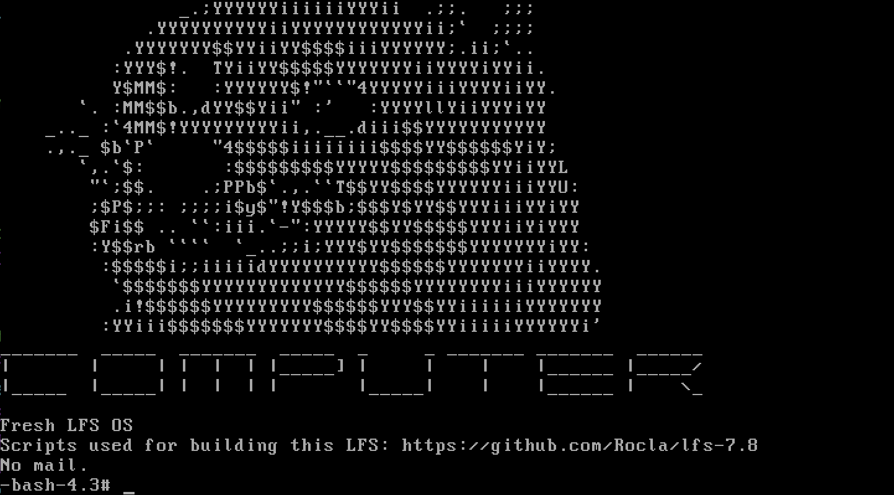
The End
Tips:
Do snapshots often!
I love pull requests :)
Slide 5/5

